Slide 1
Nashville Emergency Communications Center
Tornado and Derecho Data Analysis

Slide 2
Overview
Heat Maps of 911 Calls and CAD
911 Calls and Storm Path
The Economic Influence of Storms
Police Incidents Before and After the Storms
The Second Wave of Calls after the Storms
Key Takeaways

Slide 3
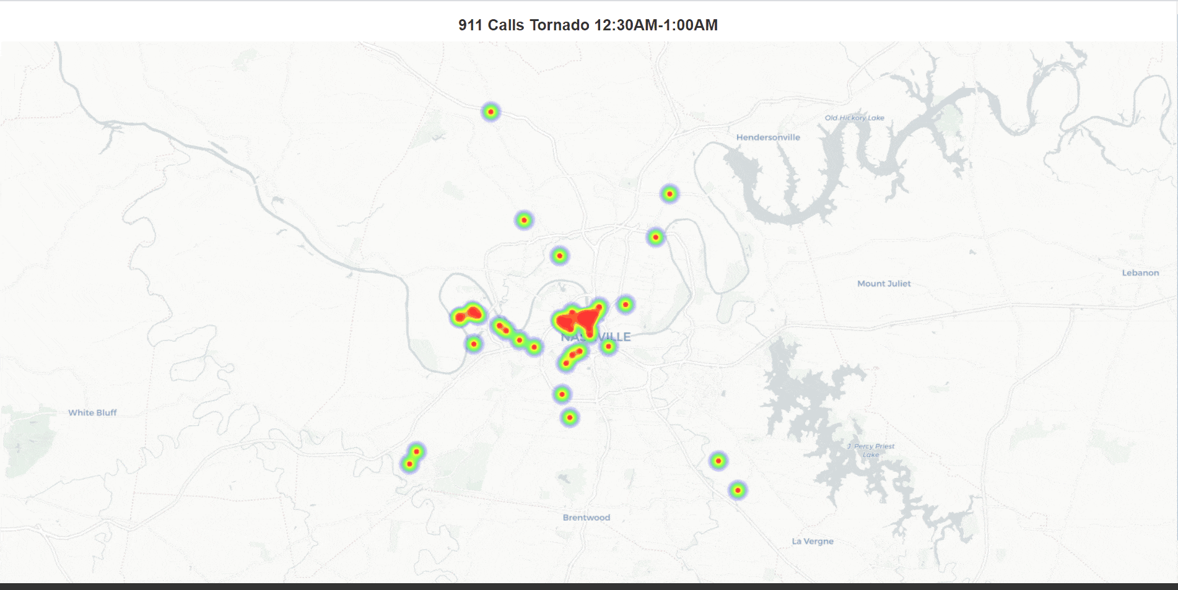

Slide 4
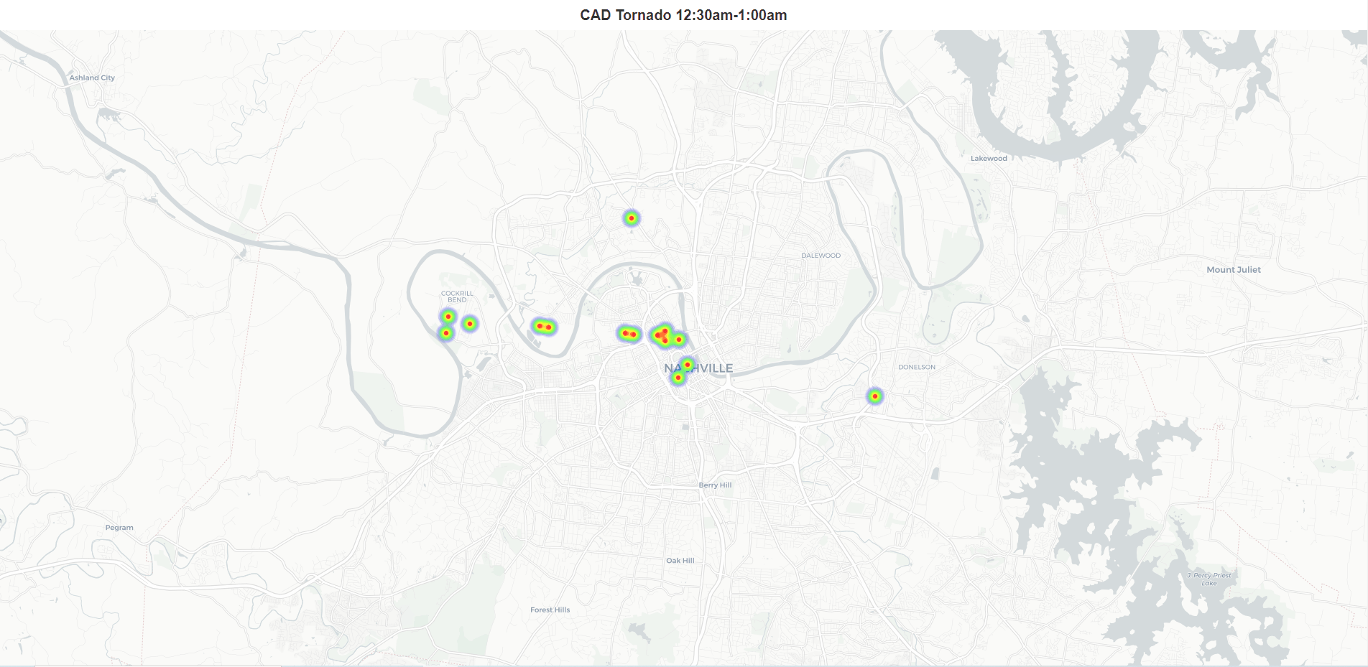
Notes:
1 - 2:30 is the height of the action.
Similar distribution to the 911 calls map.

Slide 5
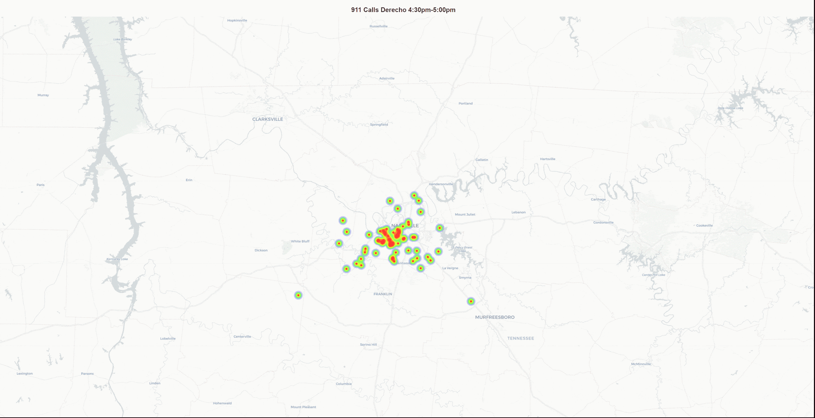
Notes:
In contrast to the tornado data we see a more widespread dispersion of the calls and dispatches for the Derecho. There is a lot of activity for both from the start of the storm at 4:30 until approximately 7:30.

Slide 7
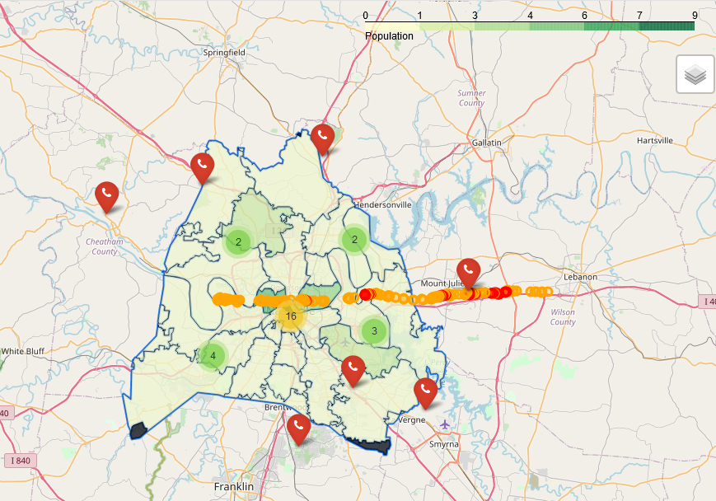
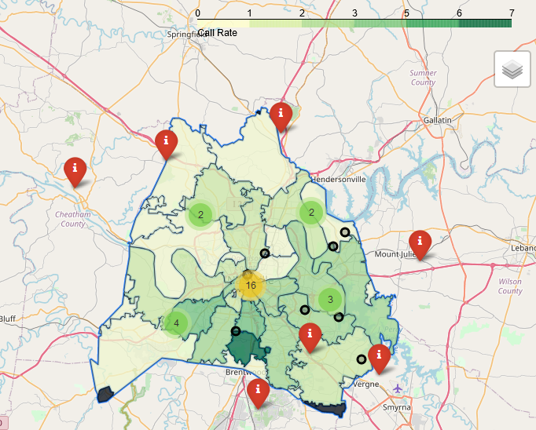
911 Calls per 1000 and Storm Path
Several zip codes along the tornado path have low rates of 911 calls
Tornado
Areas affected by the Derecho tend to have higher rates of 911 calls
Derecho
http://data-playground.com/dda2/paul_new_map_911_tornado.html
A few Zip codes with higher rates of 911 calls that are outside of the storm path
http://data-playground.com/dda2/paul_new_map_911_derecho.html

Slide 8
Economic Impact
Tornado estimated economic damage of $1.5 - $2 billion¹
15,600 insurance claims seeking $1.1 billion²
As of April 2020, only 7,400 paid out for total of $370 million
Davidson County part of twenty-county footprint to receive federal funding from derecho damage.³
$14 million in estimated damages across twenty counties.

Slide 9
Economic Impact
Link to Interactive Map:
http://data-playground.com/dda2/ross_storm_economic_map.html

Slide 10
North West Davidson County Calls vs Dispatches
Link To Interactive Map!
http://data-playground.com/dda2/owen_nw_storms_cluster.html

Slide 11
Two of Metro’s Most Wanted
During spring of 2020 Metro Davidson County was hit by two of the most disastrous natural events in memory
Tornado - March 3rd
Up to EF4 level strength(175 mph winds)
Derecho - May 3rd
State-wide natural disaster
After the devastation of these two events we were pressed with one question -- What happens in the aftermath?
We knew that the police force would be stretched thin, but what about crime?

Slide 12
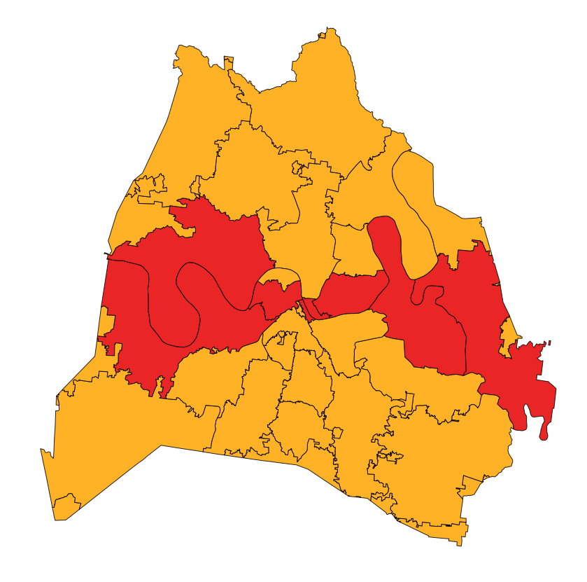
Tornado - March 3rd
Zip codes directly impacted by the path of the tornado
37214, 37206, 37208, 37209, 37076, 37201, 37213, 37218

Slide 13
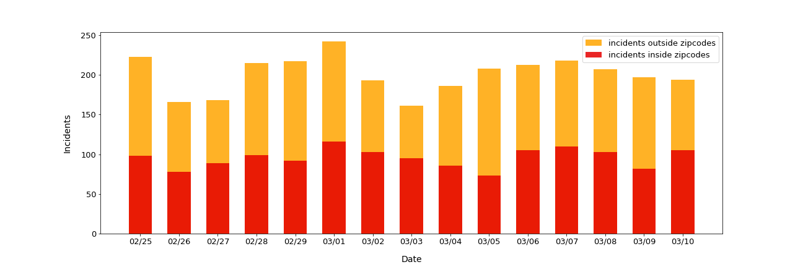
Police Incidents Before and After Tornado
Notes:
Why did we choose a 7 day time span?
The damage is the most raw from the tornado in this time frame so it gives us an idea of what's happening while a disaster is still fresh, also shortly after march 10th nashville began to shut down due to covid
Tornado before = 2099
Tornado after = 2087

Slide 14
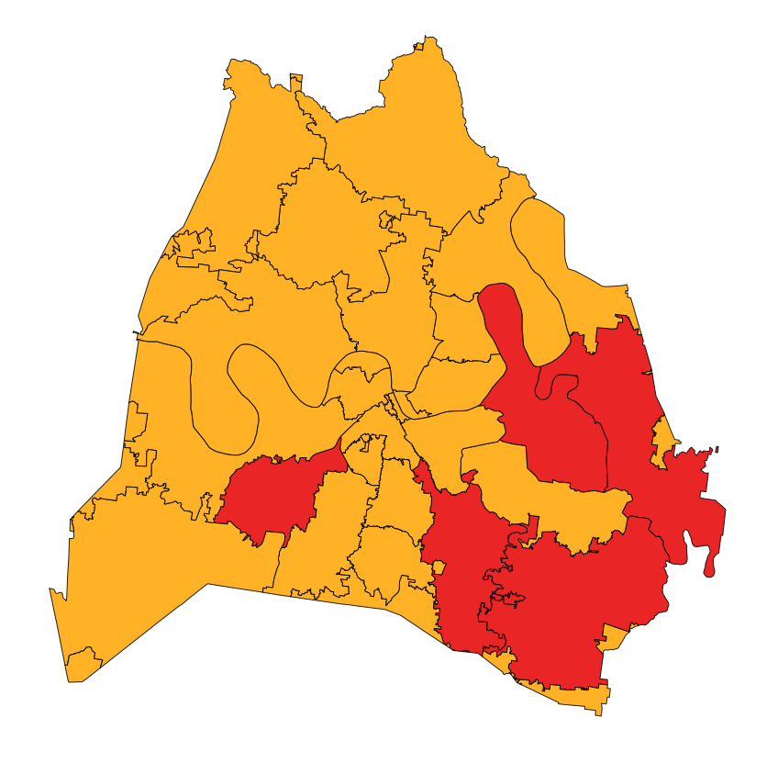
Derecho - May 3rd
Zip codes most heavily impacted by Derecho based on call volume
37211, 37013, 37076, 37205, 37214

Slide 15
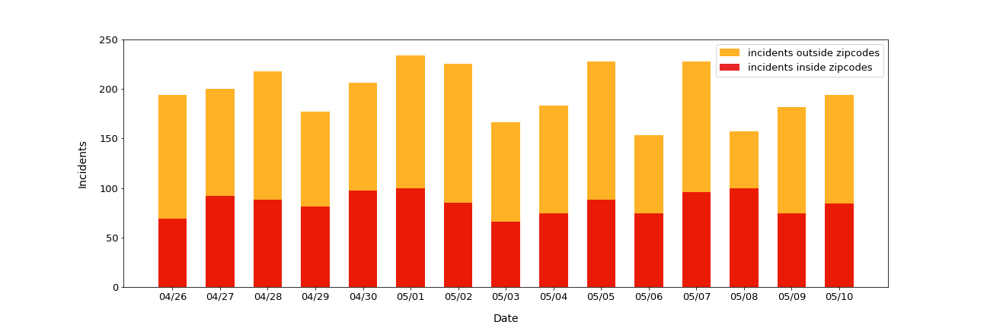
Police Incidents Before and After Derecho
Notes:
Almost identical to the tornado, outside of May 6th, the derecho had very little effect on crime incidents
Derecho before = 2066
Derecho after = 1915

Slide 16
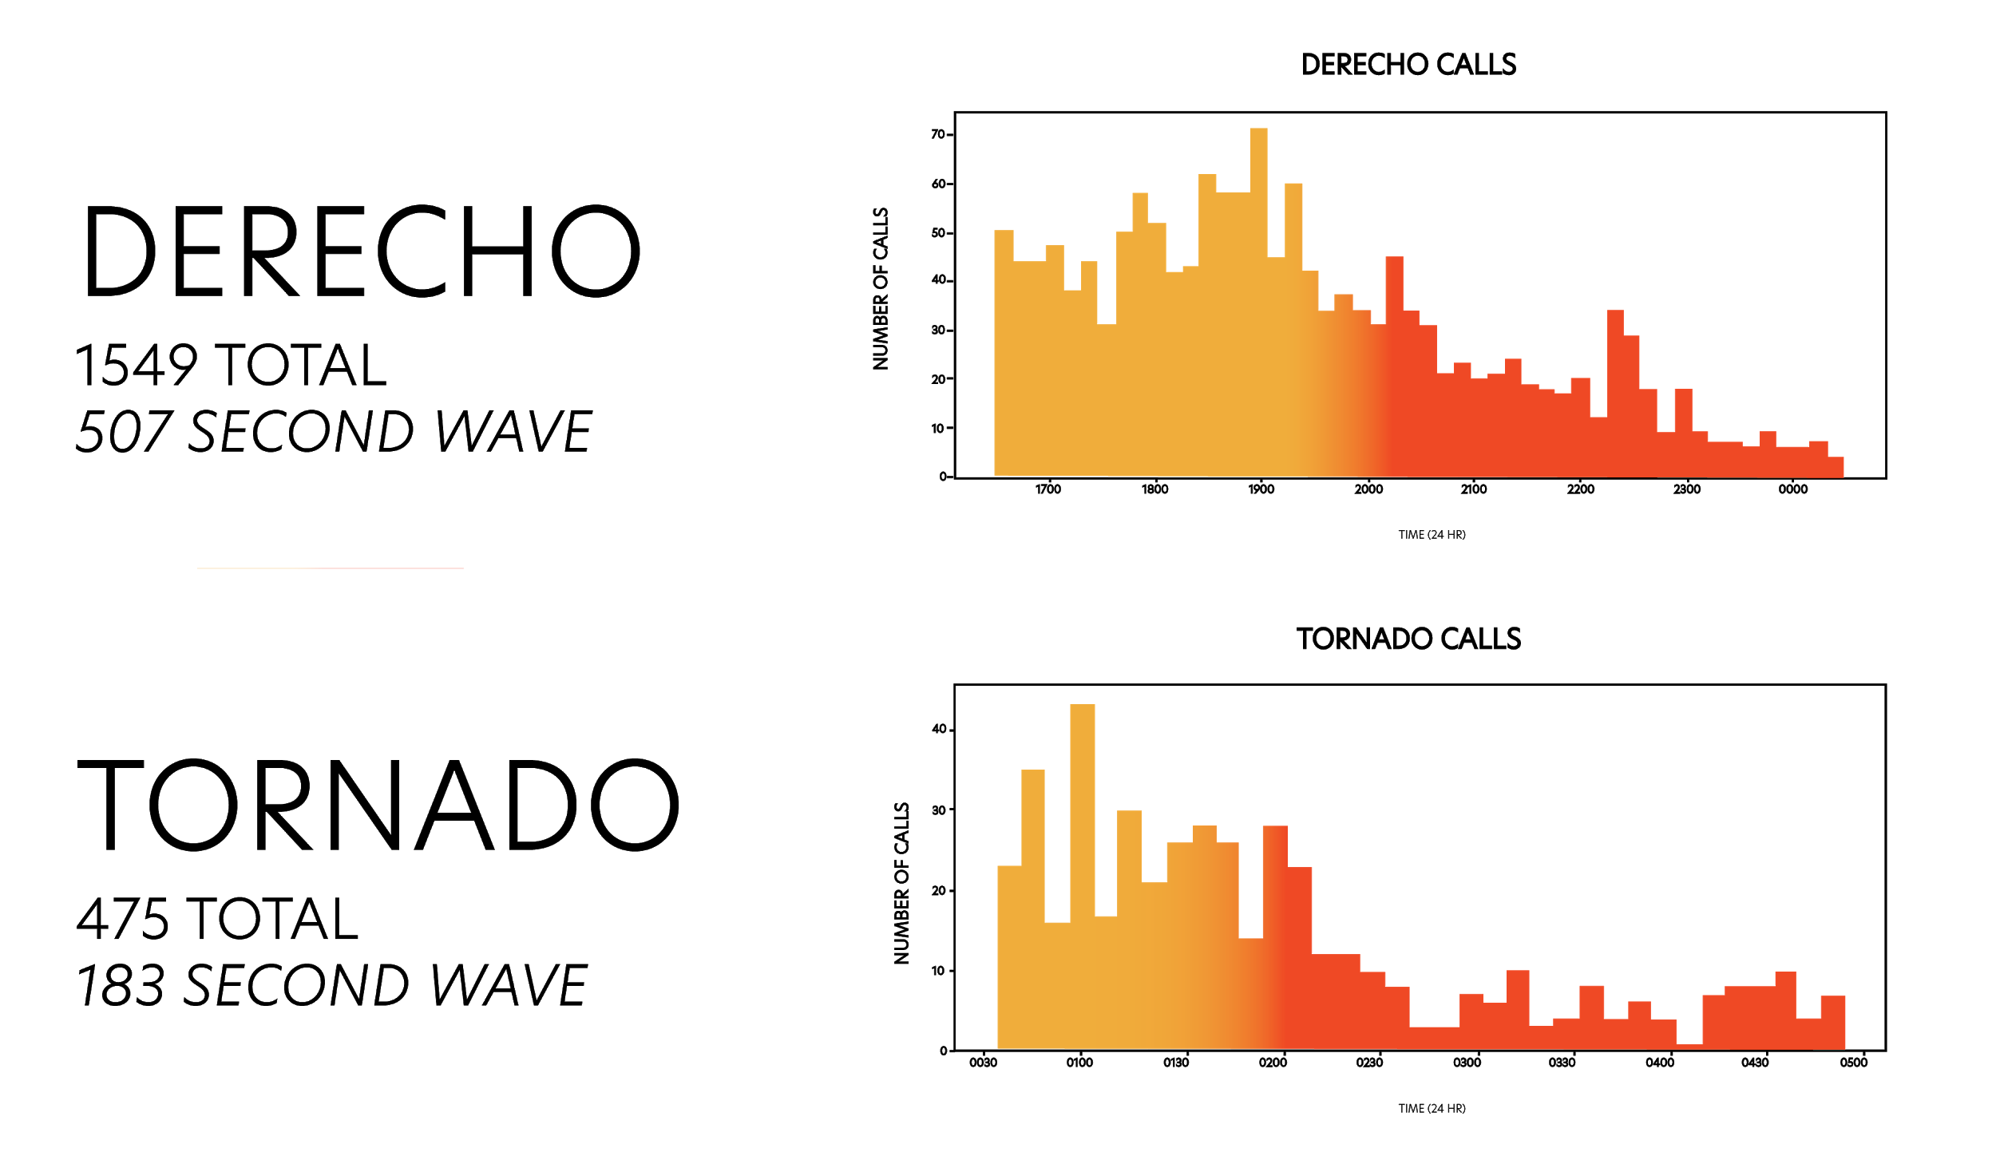

Slide 17
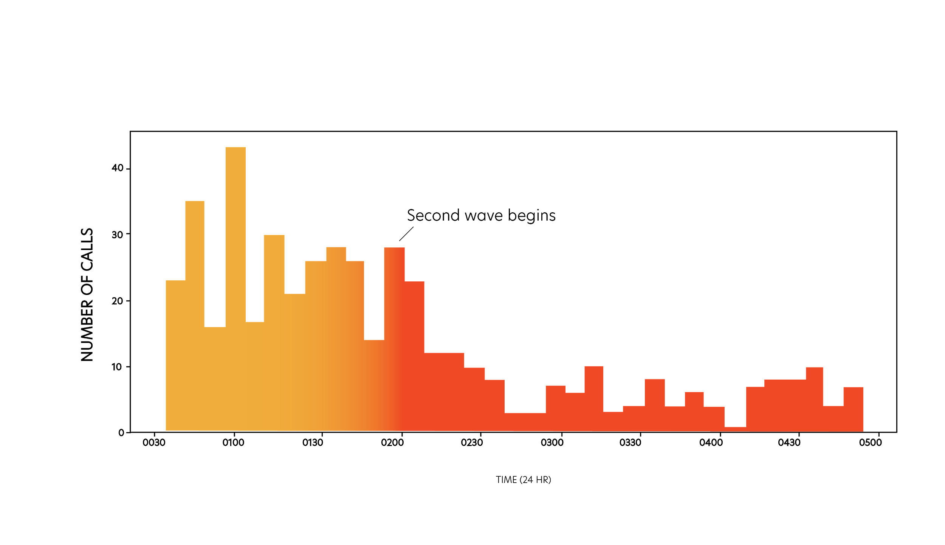
A Second Wave: The Tornado
A Second Wave: The Tornado
TIME (24 HRS)

Slide 18
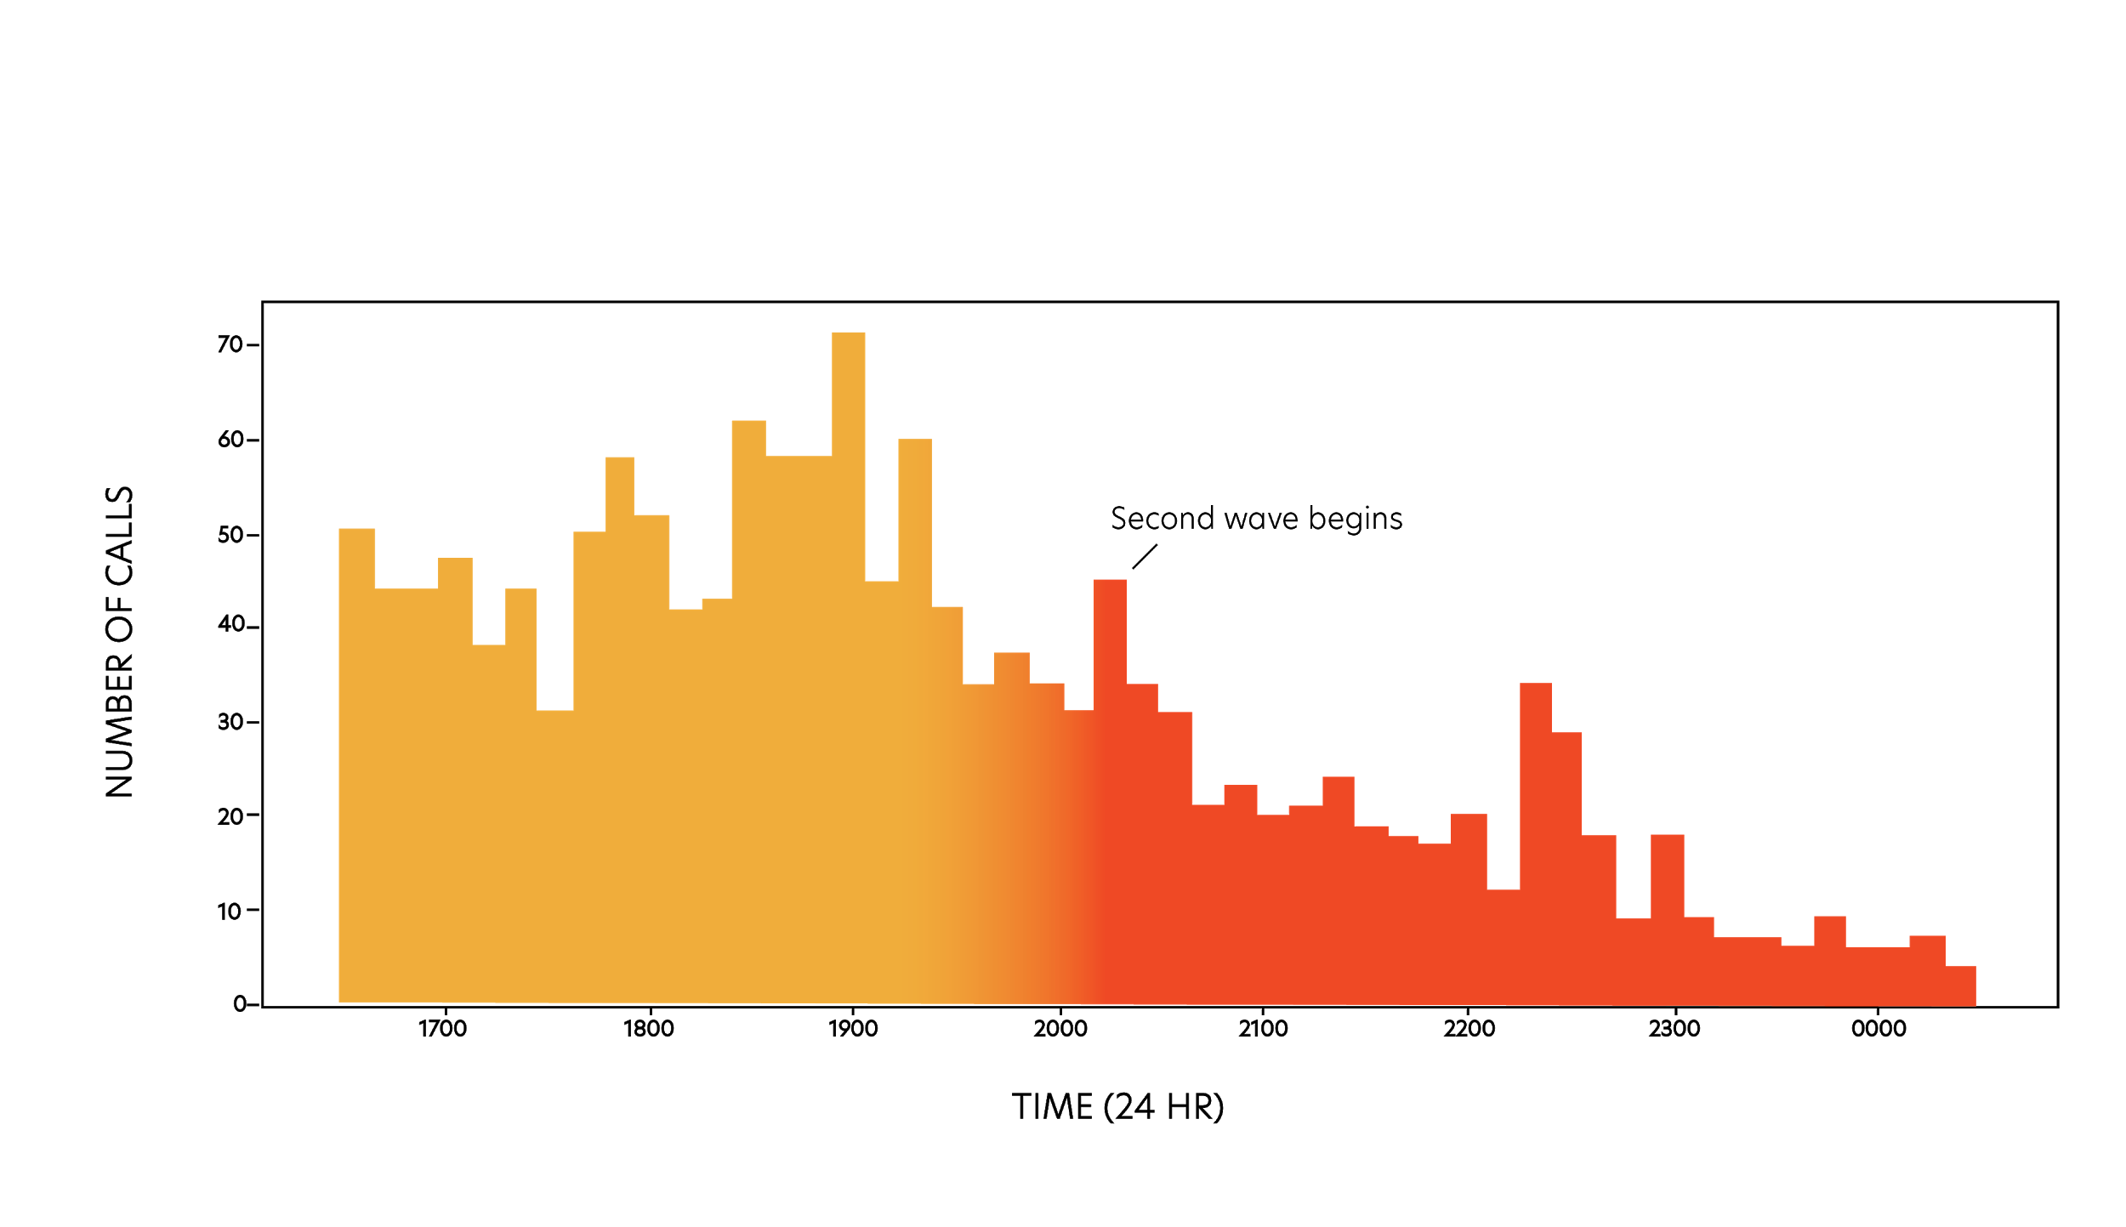
A Second Wave: The Derecho
A Second Wave: The Derecho
TIME (24 HRS)

Slide 19
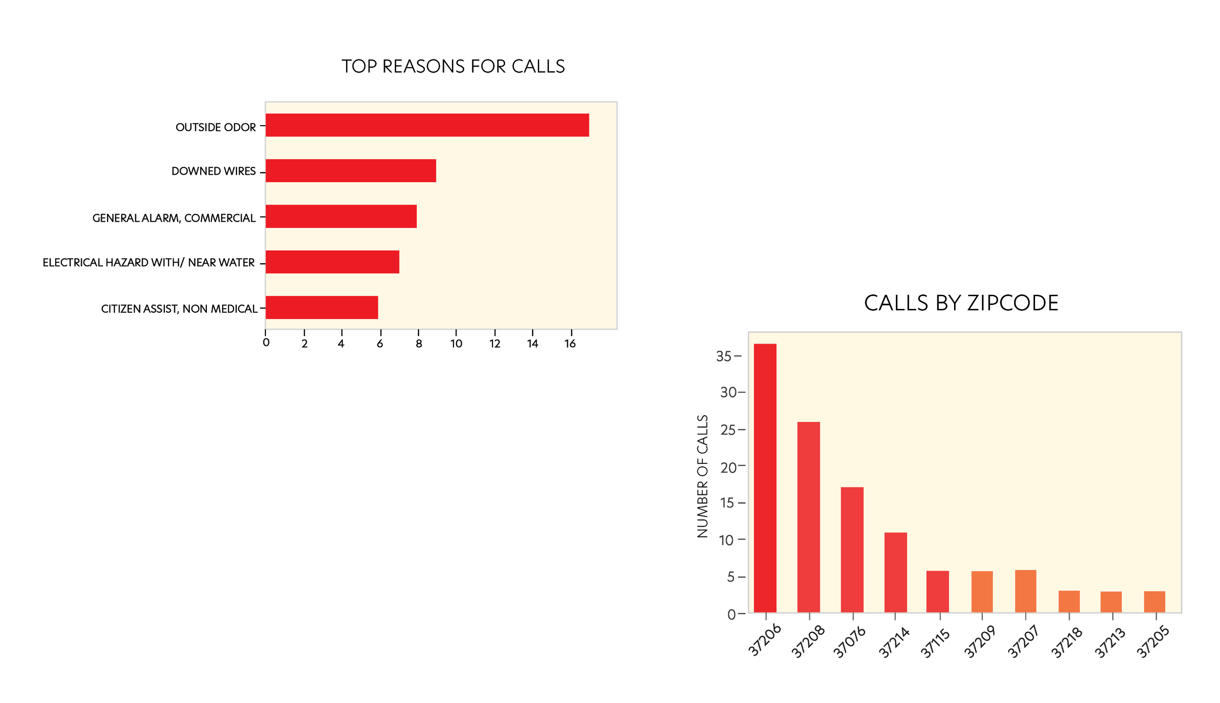
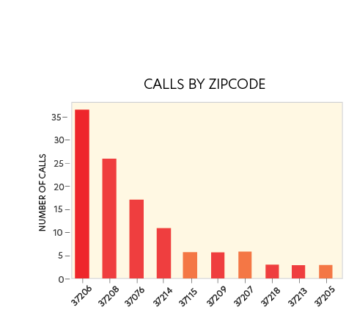
Tornado Calls
TORNADO CALLS
Second wave calls generally dealt with gas leaks, downed wires, and building alarms.
Top zip codes included the Lockeland Springs area, North Nashville, Hermitage area, and Donelson.

Slide 20
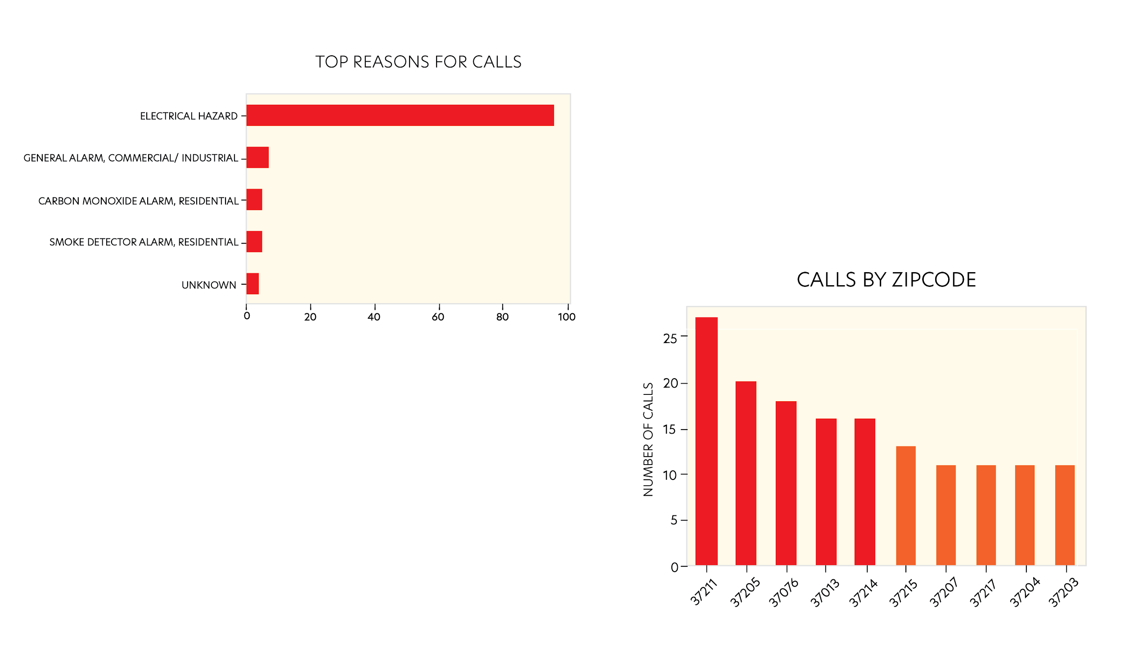
Derecho Calls
DERECHO CALLS
Second wave calls pertaining to the derecho damage were overwhelmingly in response to electrical hazards.
Top areas affected were the Nolensville Pike area, Belle Meade, Hermitage, Antioch, and Donelson.

Slide 21
Key Takeaways
As expected, the location of incoming 911 calls are closely related to the path of each storm.
Economically disadvantaged neighborhoods were heavily impacted by both storms, may be underinsured and require more public relief assistance
You can rest assured that crime never sleeps
Expect a second wave of calls 2-4 hours after a natural disaster

Slide 22
Appendix
Additional Sources
¹https://www.accuweather.com/en/severe-weather/accuweather-estimates-the-total-damage-from-the-tennessee-tornadoes-will-approach-2-billion/697185#:~:text=AccuWeather%20estimates%20the%20total%20damage%20and%20economic%20loss%20caused%20by,Myers.
²https://www.insurancejournal.com/news/southeast/2020/04/27/566394.htm
³https://www.tn.gov/governor/news/2020/7/10/gov--bill-lee-announces-20-tn-counties-will-receive-federal-recovery-assistance-for-may-derecho---storm.html

